Slide 2

Russell Wilson
IBM United Kingdom Ltd &
zopen community contributor

Slide 3

DevonianTeuchter
zopen community contributor &
IBM United Kingdom Ltd

Slide 4
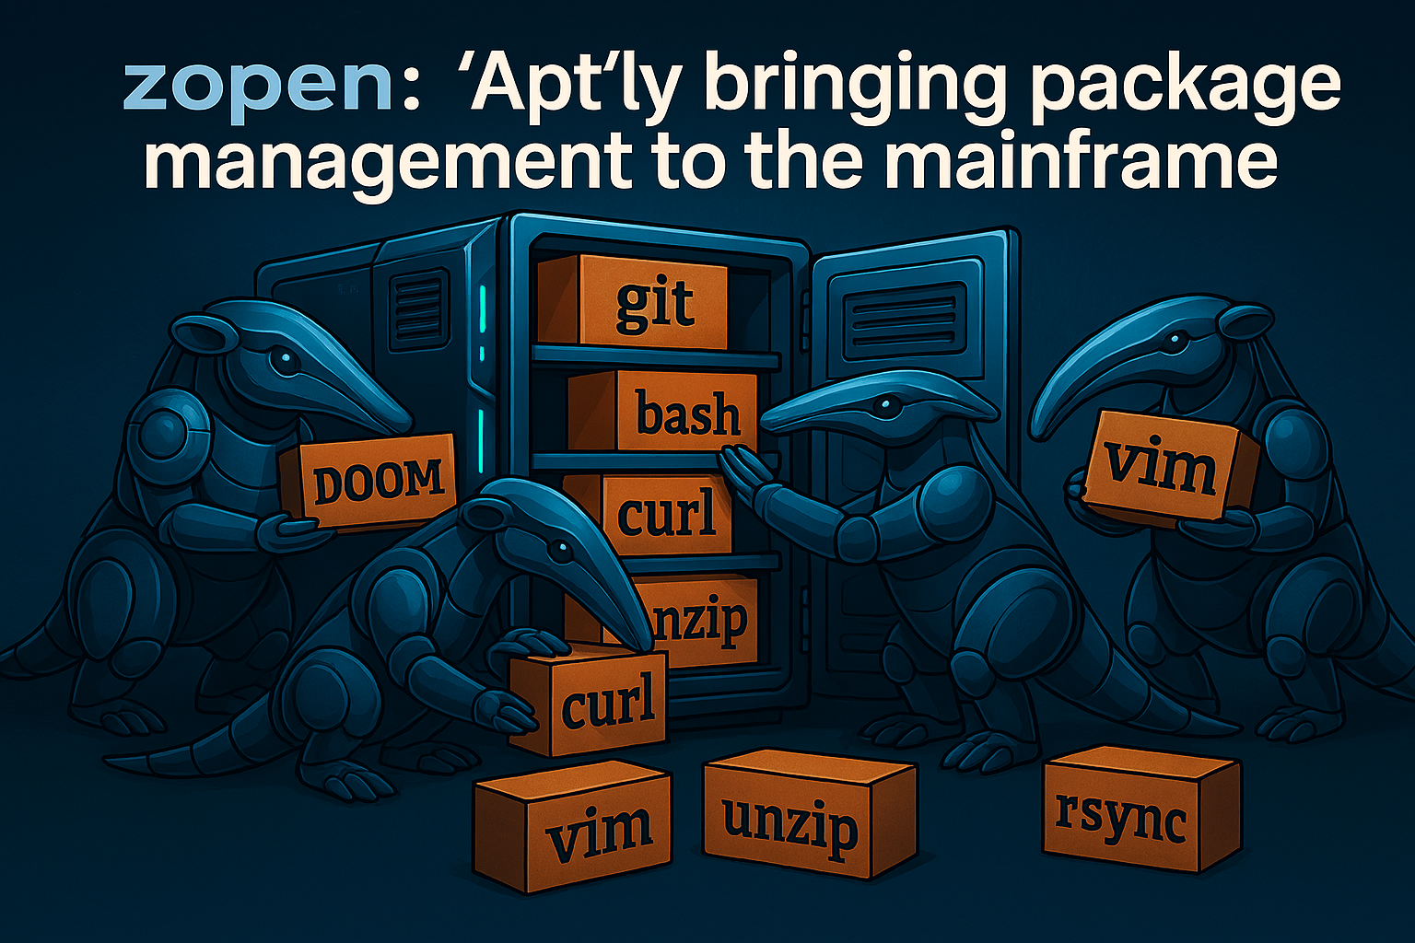
*Ai generated, I can't draw...

Slide 5
zopen-community --info
The zopen community is here to provide popular Open Source tools and to encourage z/OS Open Source tools development. We currently host 200+ z/OS Open Source projects [and we're looking for more!]
The zopen community project continues to be volunteer-driven and community-supported, now under the umbrella of the Open Mainframe Project. It is maintained and supported by volunteers from the community, including individuals and organizations passionate about open source on z/OS.

Slide 6
zopen –info | head
zopen is the package manager for the zopen community's suite of tools
A package manager is a tool that automates the installation, update, and removal of software while handling dependencies and version control across a system. Think SMP/E but without navigating ISPF or crafting JCL or … – just issuing a simple command from the terminal
Ultimately puts files on disk in certain locations but can perform tasks such as building by compiling and linking

Slide 7
zopen –info | tail
Package managers themselves might only handle local packages, requiring a repository manager utility.
Examples*:
dpkg & apt Debian-based Linux systems eg. Ubuntu (often used in WSL & docker)
rpm (available on AIX and IBM I) - needs repo manager like dnf, yum or zypper
Pacman (Arch Linux), portage/emerge (Gentoo), sdkman (Linux?), flatpak(Linux), snap(Linux), Chocolatey/Scoop/Ninite/Winget (Windows), Warpin (OS/2!), conda/miniconda (python), brew (Mac OS)...
*risking a VI/Emacs-type flame war over non-exhaustive list of possible package managers!

Slide 8
zopen --ports
Packages are the shipped artifact of a zopen community "port" - each port having it's own repository under the zopencommunity project on github.com
Build environment configured using buildenv
Source taken directly from upstream projects. For example: github.com/git/git or a source package
Built using appropriate tools in a CD/CI environment: C compiler, Go, Python, make, …
Use pax format – fairly common on z/OS, less so elsewhere
Packages can be downloaded from the zopen community GitHub repository, extracted using pax rf <package> && . .env [which adds the package to $PATH] and then run from the terminal
*pinentry also included as a pre-req of gpg

Slide 9
zopen --why
Installing multiple package pax files – possible but gives an unwieldy $PATH, possibly exceeding system limits [or at least of readability!]
No dependancy tracking – manual discovery and download of any pre-reqs [and pre-reqs for those pre-reqs]
Simpler version management
Upgrade available? zopen upgrade
Revert to previous? zopen alt
Remove? zopen remove

Slide 10
zopen –details | head
Written in POSIX.1 shell – compliant with /bin/sh , no requirement for alternative shells like bash or zsh
Available in a single pax file, including bootstrapped utilities or through an executable script [with a pre-req of curl]
Utilises various Open Source utilities [contained in the pax]
jq - handle package management and metadata
gpg - provides package signing and verification*
curl – package handling (downloading)
Sanitizes PATH, LIBPATH, MANPATH environment to prevent "unwieldyness" - can have all 250+ packages installed
*pinentry also included as a pre-req of gpg

Slide 11
zopen –details | tail
Can be used by sysadmins to create read-only installations of tools for users
End users can create own customized environment of tools – useful if the sysadmin versions are out of date or if the user requires additional tools without sysadmin authority
Development version can be used in air-gapped environments – packages can be uploaded to the system or placed in authorised locations and installed using the tooling in an "offline" mode
*pinentry also included as a pre-req of gpg

Slide 12
Demo time...

Slide 13
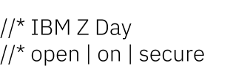
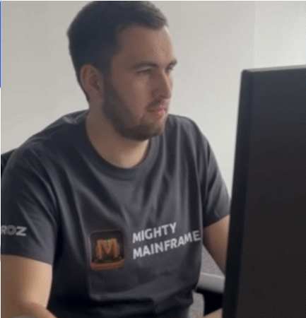





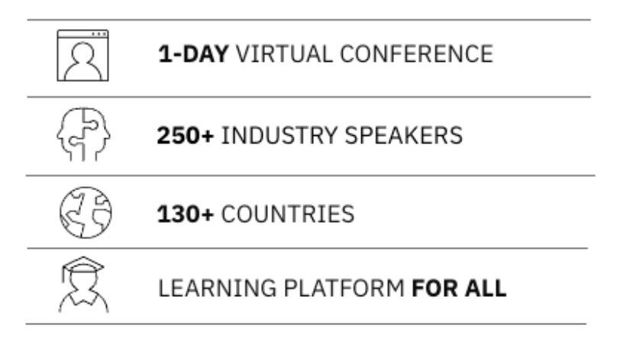



12 November 2025
IBM TechXchange Virtual Event
IBM Z’s largest tech event of the year
Dive Into 6 Technical Tracks
IBM Z Makes More Possible – More Precision | Security | Innovation
Don’t miss IBM Z Day 2025 on November 12th from 8 AM – 4:30 PM ET (IBM Z Skills Acceleration track starts at 12 AM ET), for an exclusive look at the latest innovations from IBM Z and LinuxONE. Earn 4 industry recognized badges and take your career to new heights.
IBM Z
AI & Data
App Dev & IT Ops
– FREE!
Security
250+
IBM Z Skills Acceleration
165+
Extended 16 ½ hour track (12 AM to 4:30 PM ET)
Ecosystem in Action
Register now >>
ibm.biz/ibmzday-2025

Slide 14
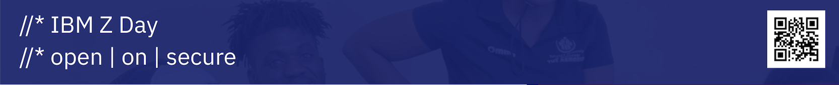

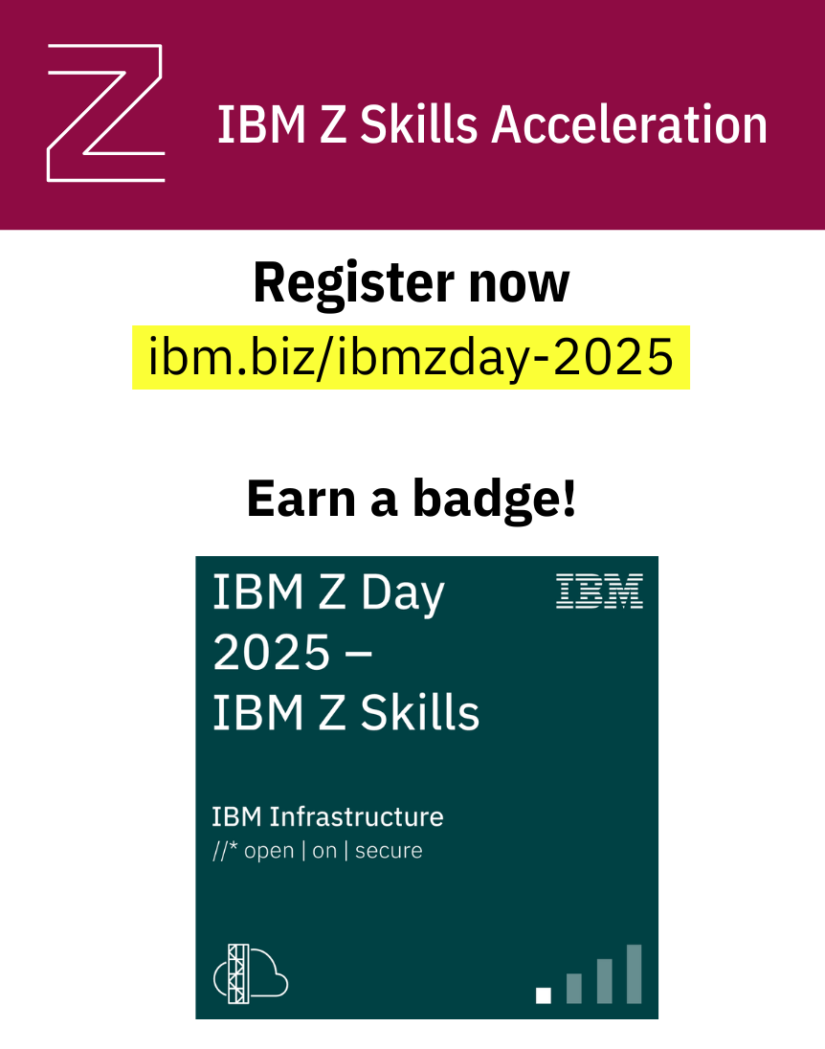

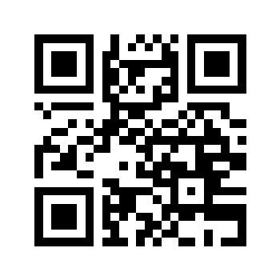
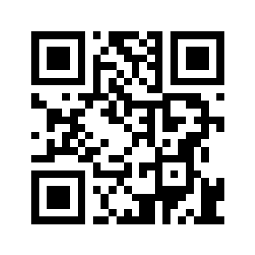


Let’s build a mainframe playlist
Submit your song
Send an email
or
Complete the form
Register for IBM Z Day
ibm.biz/ibmzday-2025
The Mainframe Soundtrack – A New
Z Day “Track”
12 November 2025 | 3:30 – 4 pm ET
Attend the session to unlock the soundtrack
14

Slide 15
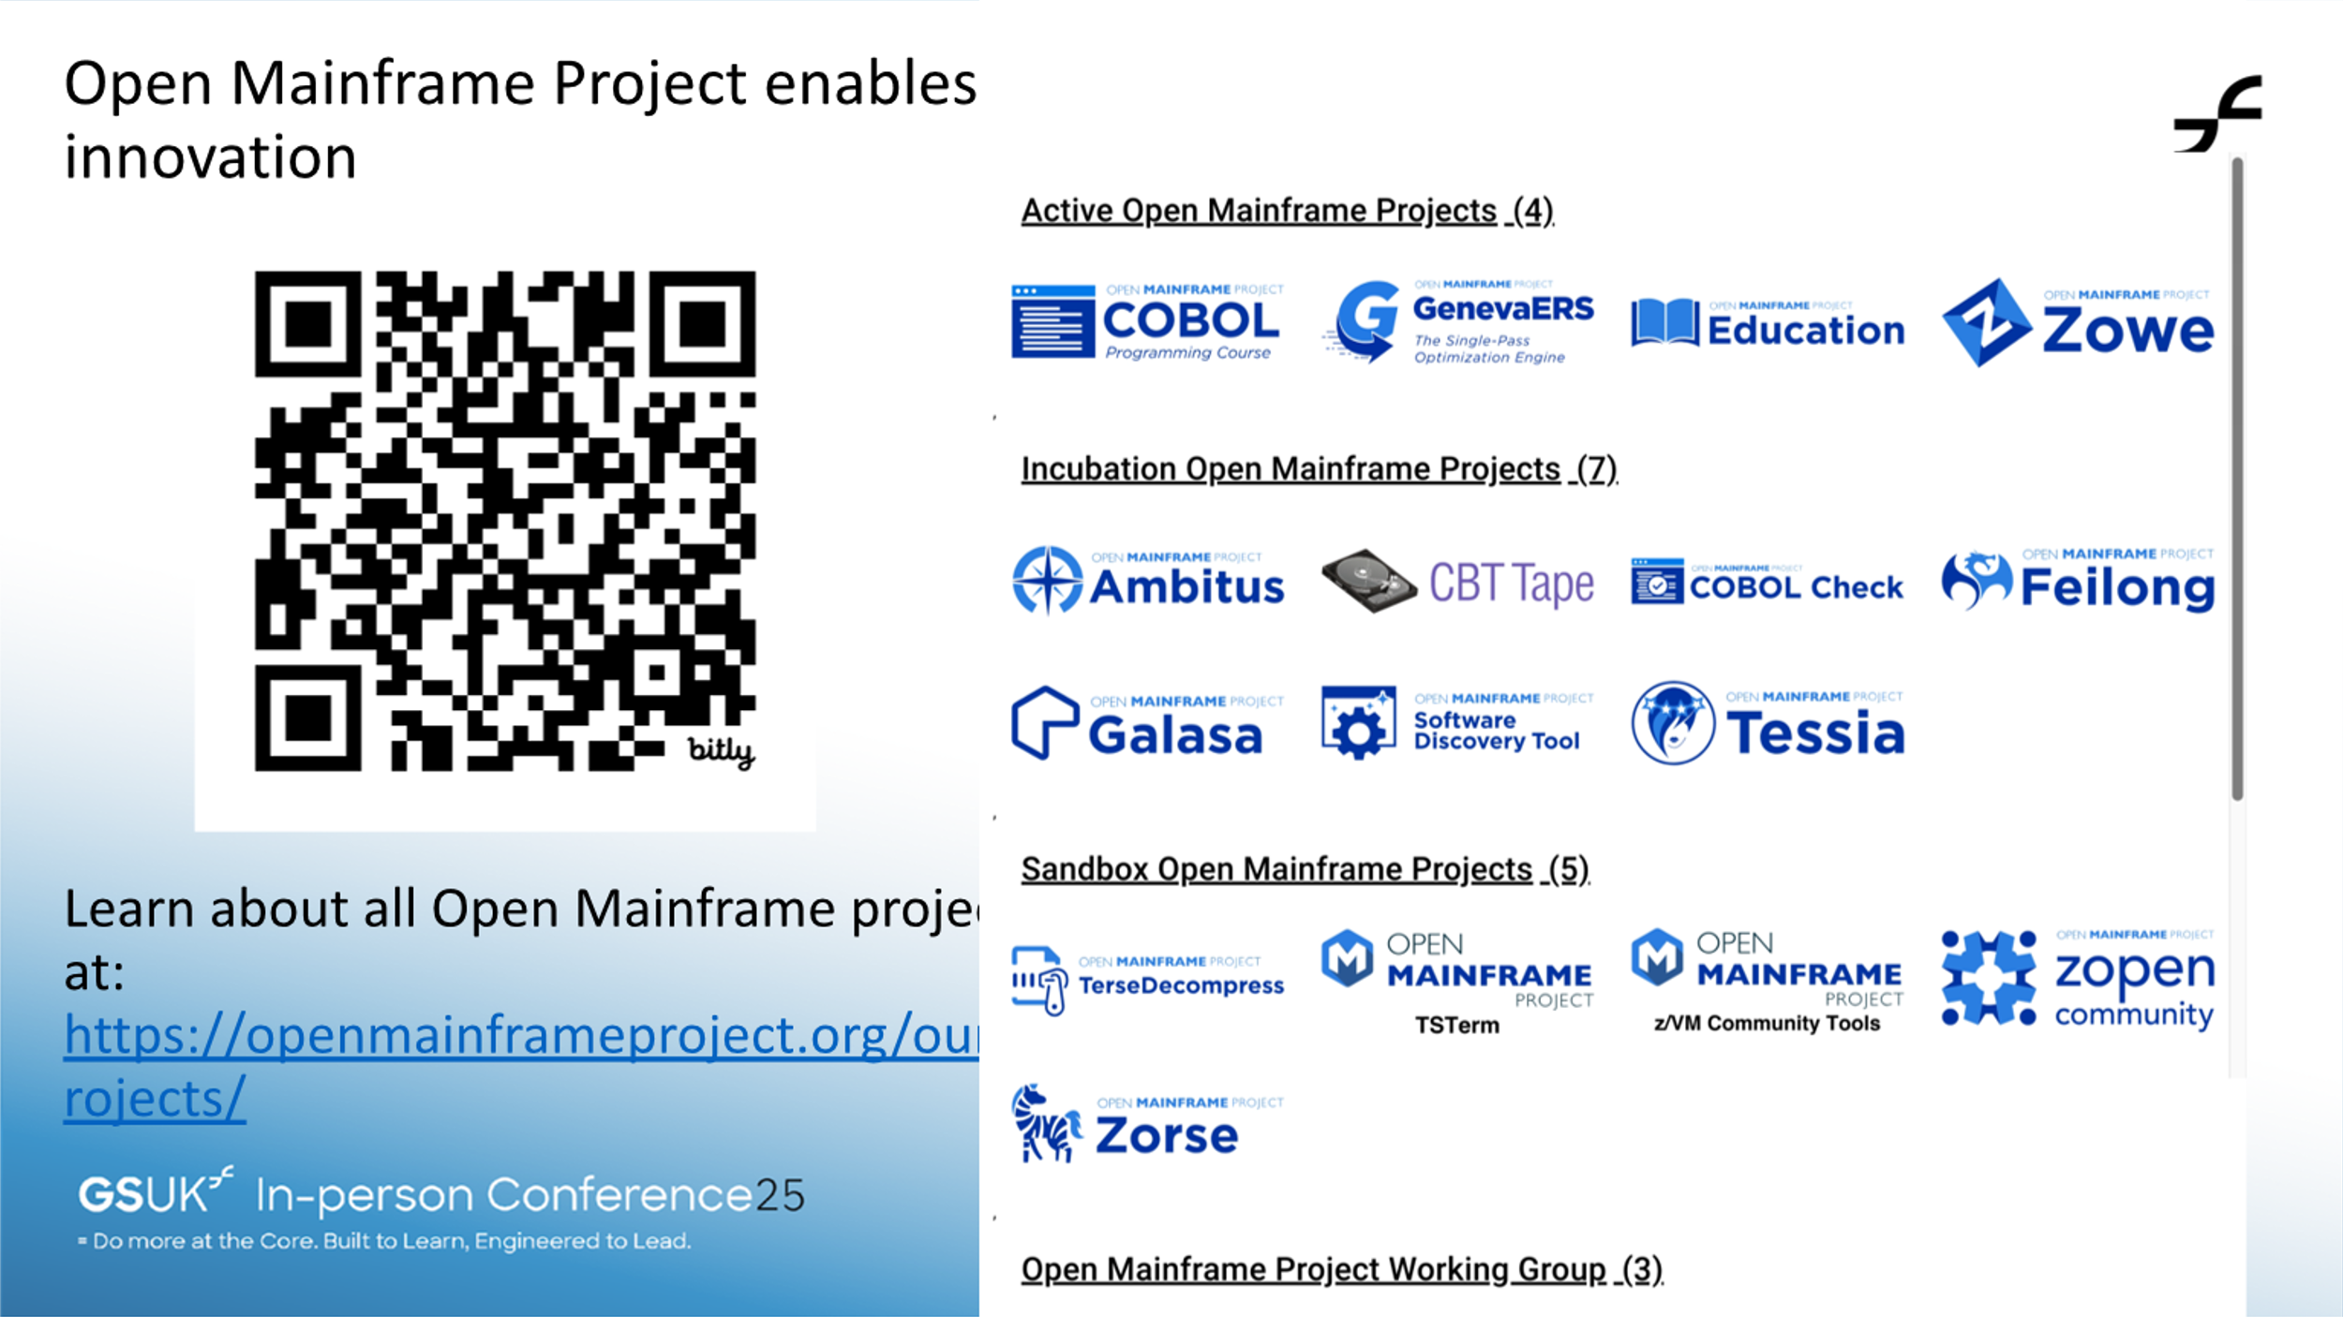

Slide 16
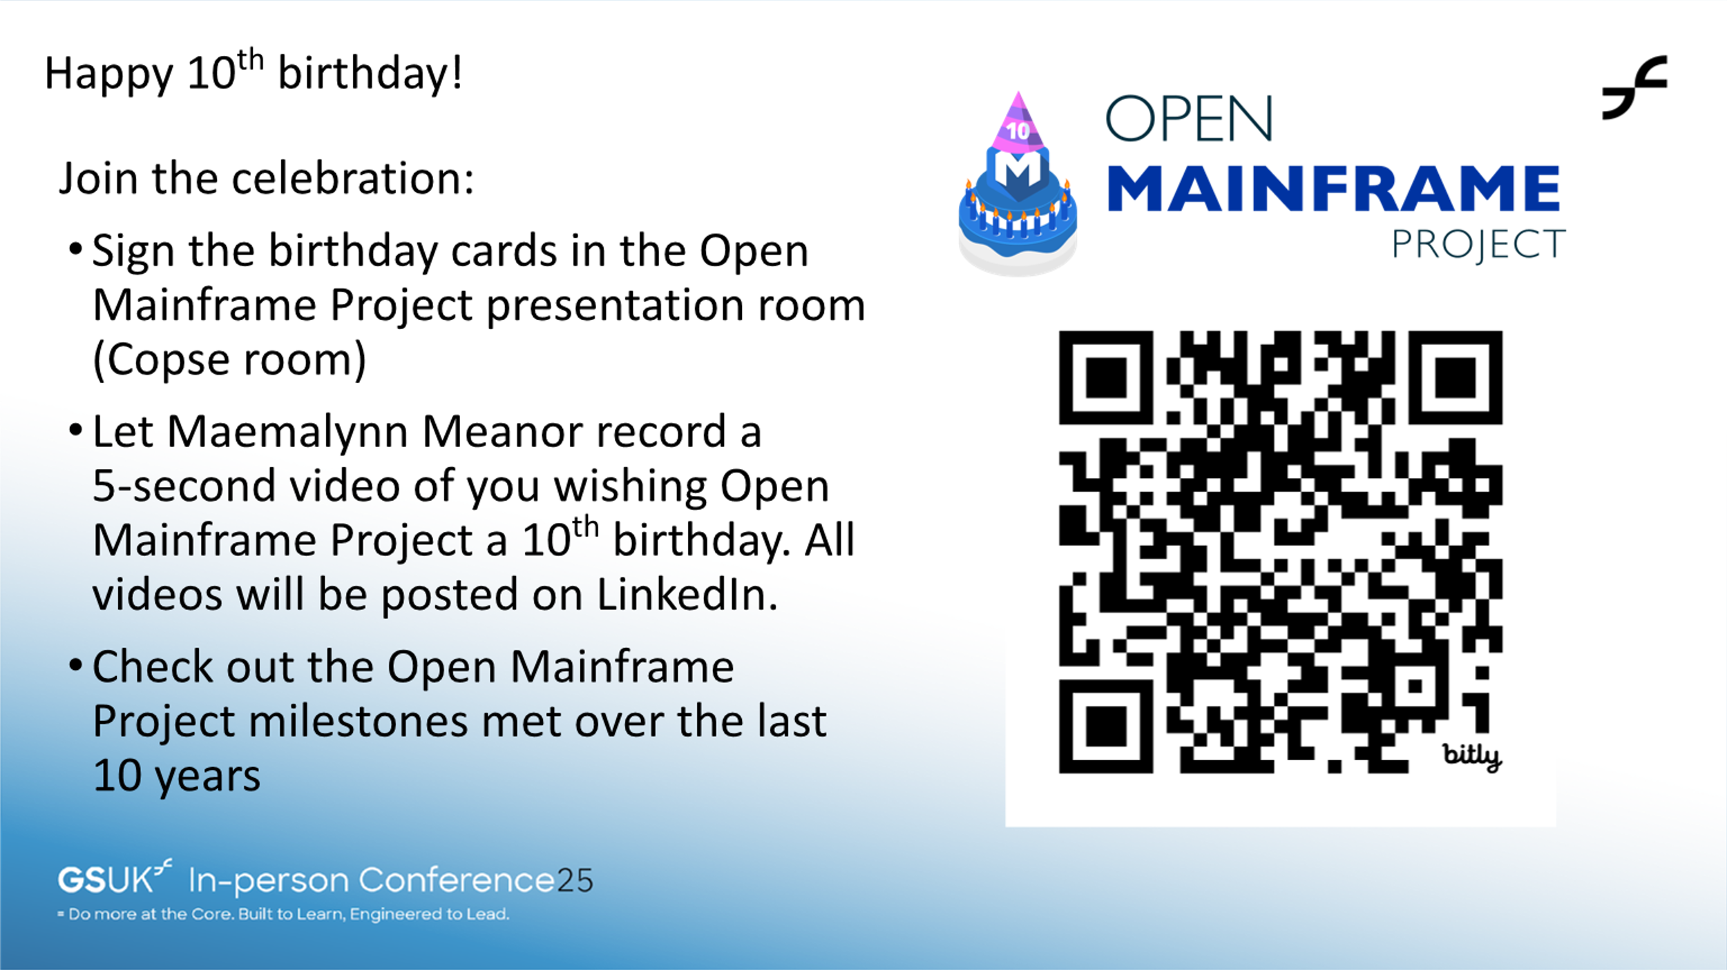

Slide 17
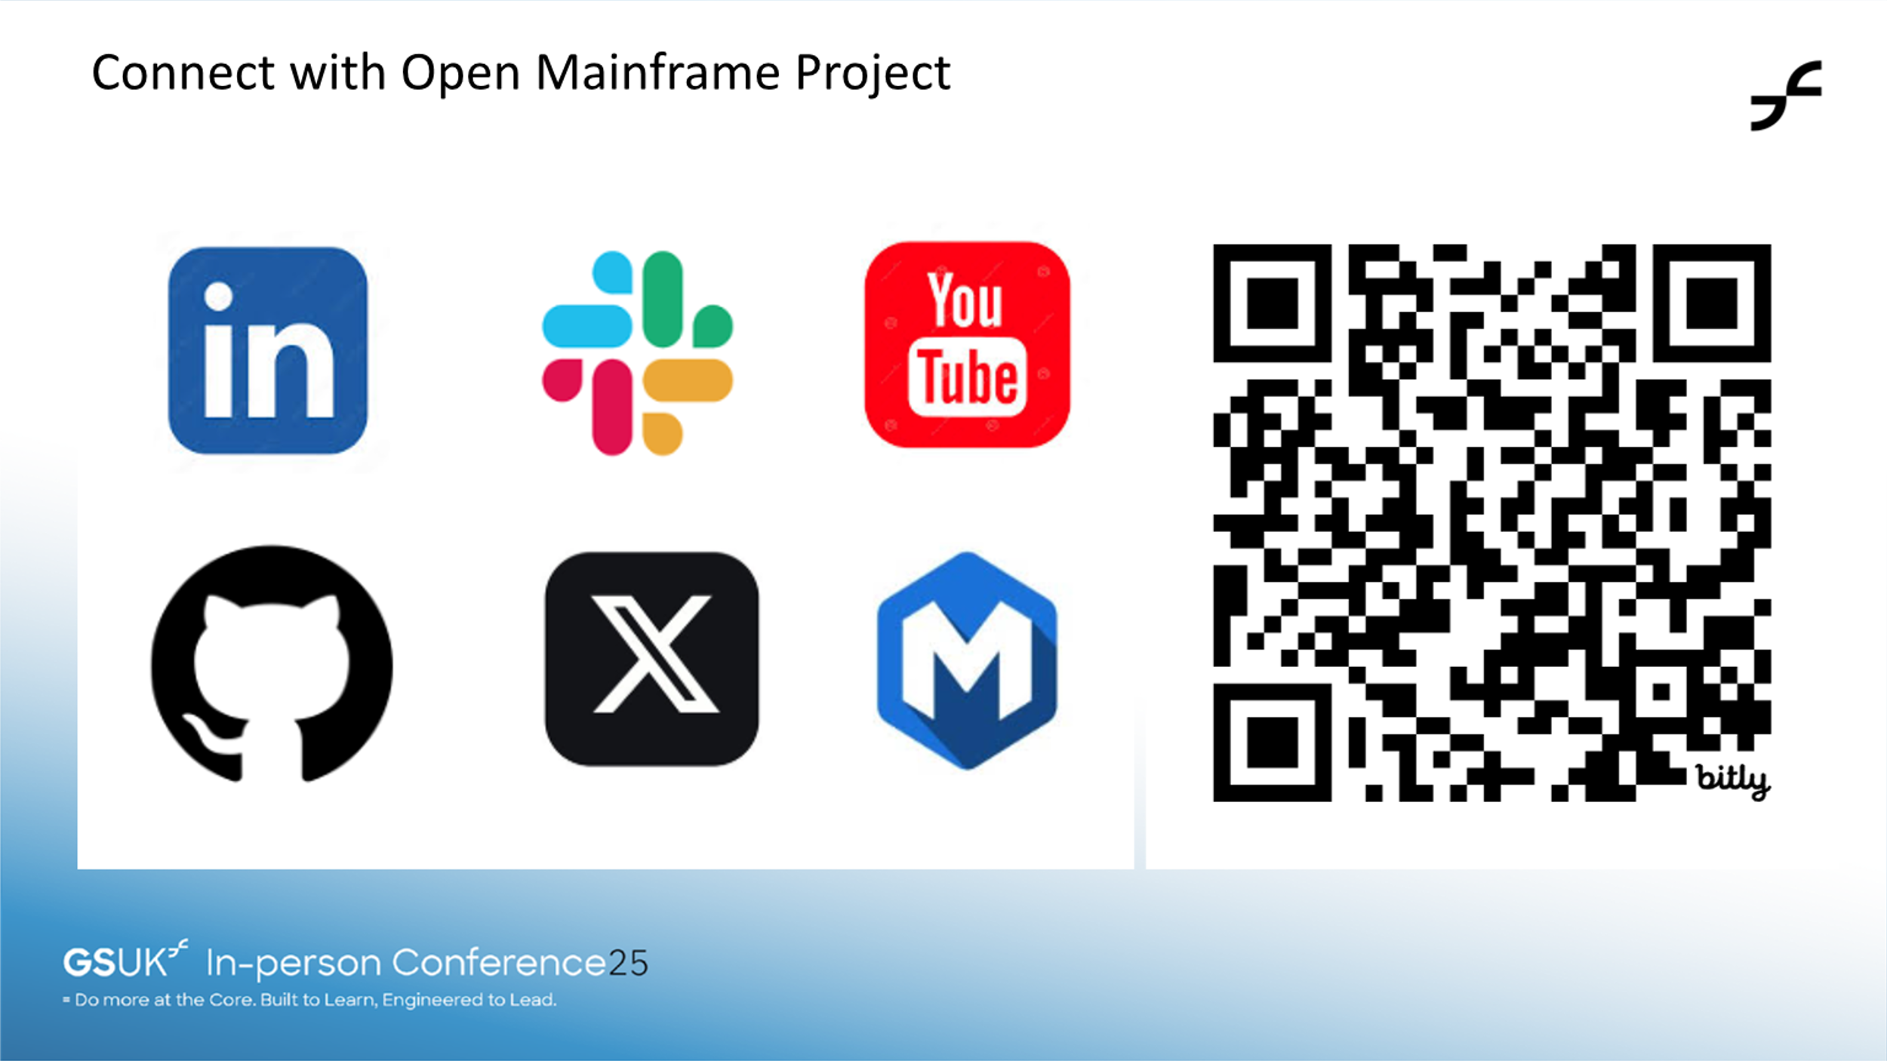

Slide 18
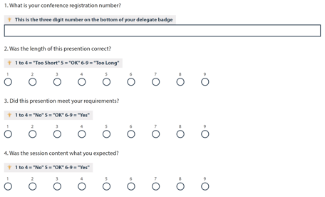
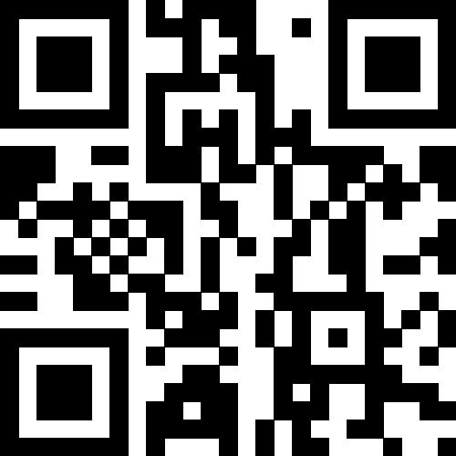
Session feedback
Submit your feedback at https://conferences.gse.org.uk/2025/feedback/NW
Make sure you are signed into MyGSE
The session code is NW

